Slide 1


Data-driven Economics
Exploring socio-economic factors impacting marriages and divorces: a Panel Data Analysis
Data Science - 2023/24

Slide 2

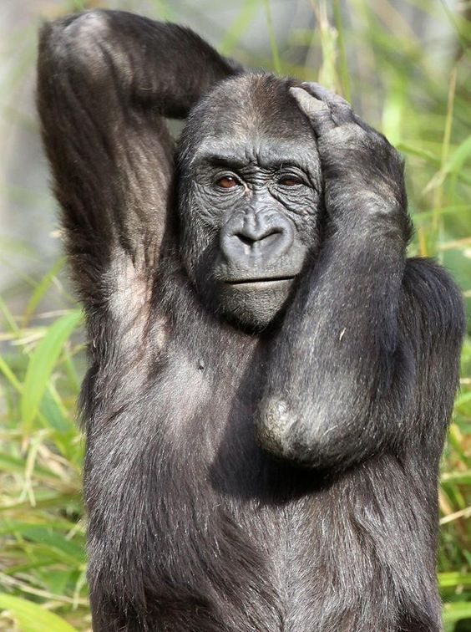
Problem Overview - Main Goal
In our study we would like to understand how welfare can influence the western social “micro-structure”, based on the concept of monogamy and family.
We are interested in how the change in stress levels, poverty, competitiveness and female empowerment are determinants in shaping our social rules and habits:
Are people more prone to divorce over the years?
How can gender inequality change the social structure?
Do changes in the gender gap have the same effect on the number of new marriages and two new divorces?
Source if inspiration:
From biology research involving primate species, it appears that the role of the female, the level of inter-subject competitiveness, and physical characteristics of the primate are decisive in the imposition of a polygamous or monogamous structure!
Does woman also define the nature of romantic relationships in human society?

Slide 3



Problem Overview – Balanced Panel Data
What : we study the causal relationships between socioeconomic factors such as net median income and employment rate, and levels of new marriages and divorces in different European nations. In particular, we analyze how indices of welfare distinctly by sex are influencing social relationships.
Where: we focus the analysis across 25 European countries
When: we restricted the study over 14 years (2009-2023)
Why: The findings from this analysis can have significant policy implications for governments and policymakers. Understanding the factors influencing marriage and divorce rates can inform the design of targeted interventions aimed at promoting stable family structures and social well-being
Sources: EUROSTAT United Nations

Slide 4
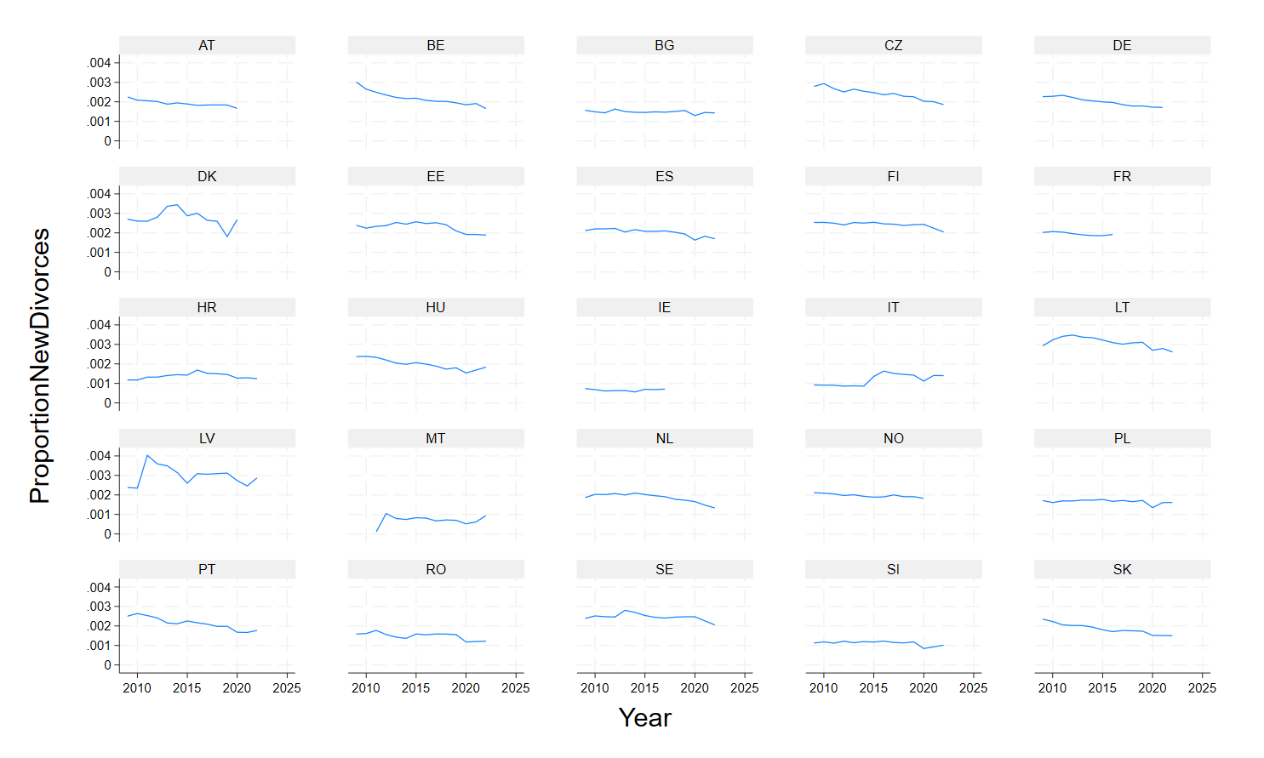

Exploratory Data Analysis
Dependent variable(s)
Let’s start from our DEPENDENT variables…
The number of new divorces across countries for each year is normalized by the country population.
We can’t infer any trend or pattern from these plots, but it is evident that we have some missing data and our panel dataset could be considered unbalanced, based on our missing values management strategy!

Slide 5
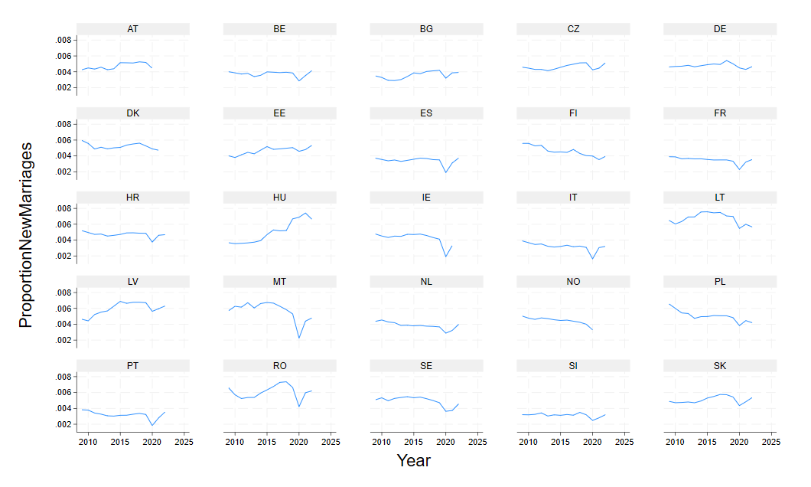
Exploratory Data Analysis
Dependent variable(s)
The number of new marriages across countries for each year is normalized by the country population.
In this case the curves seem to vary more across countries, but it is interesting to note a common local minimum corresponding to the pandemic year (2020), in contrast with the number of divorces (which did not show any minimum or maximum).

Slide 6
Exploratory Data Analysis
Independent variables
We collected independent variables such as economic indicators and welfare indicators, sometimes distinguishable by gender, referring to a particular country in a particular year:
Variable | Unit | Description
Female/male median and mean incomes | Euro | Average or median net income by gender
Female/male employment rates | % of tot. population | Proportion of new employees hired by gender
GDP | Milions of euro | Gross domestic product
Closing housing price | NSA in (2015=100) | Average house price in the last quarter of the year
Female/male tot. population | Thousands of people | Ratio of inhabitants by gender
Mean age of childbearing | Floating number | Mean age of women at birth of first child is the weighted average of the different childbearing ages, using as weights the age-specific fertility rates of first-order births.
Fertility rate | Floating number | Ratio of the number of live births to mothers of age x to the average female population of age x
Ratio of female people in reproducible age | % of female population | Ratio of female people in reproducible age (15-49 y.o.) over total female population
Female people working from home | % of female population | Ratio of female people working from home over total female population
Birth rate | Floating number
CPHI | N.D. | Consumer price harmonized index

Slide 7
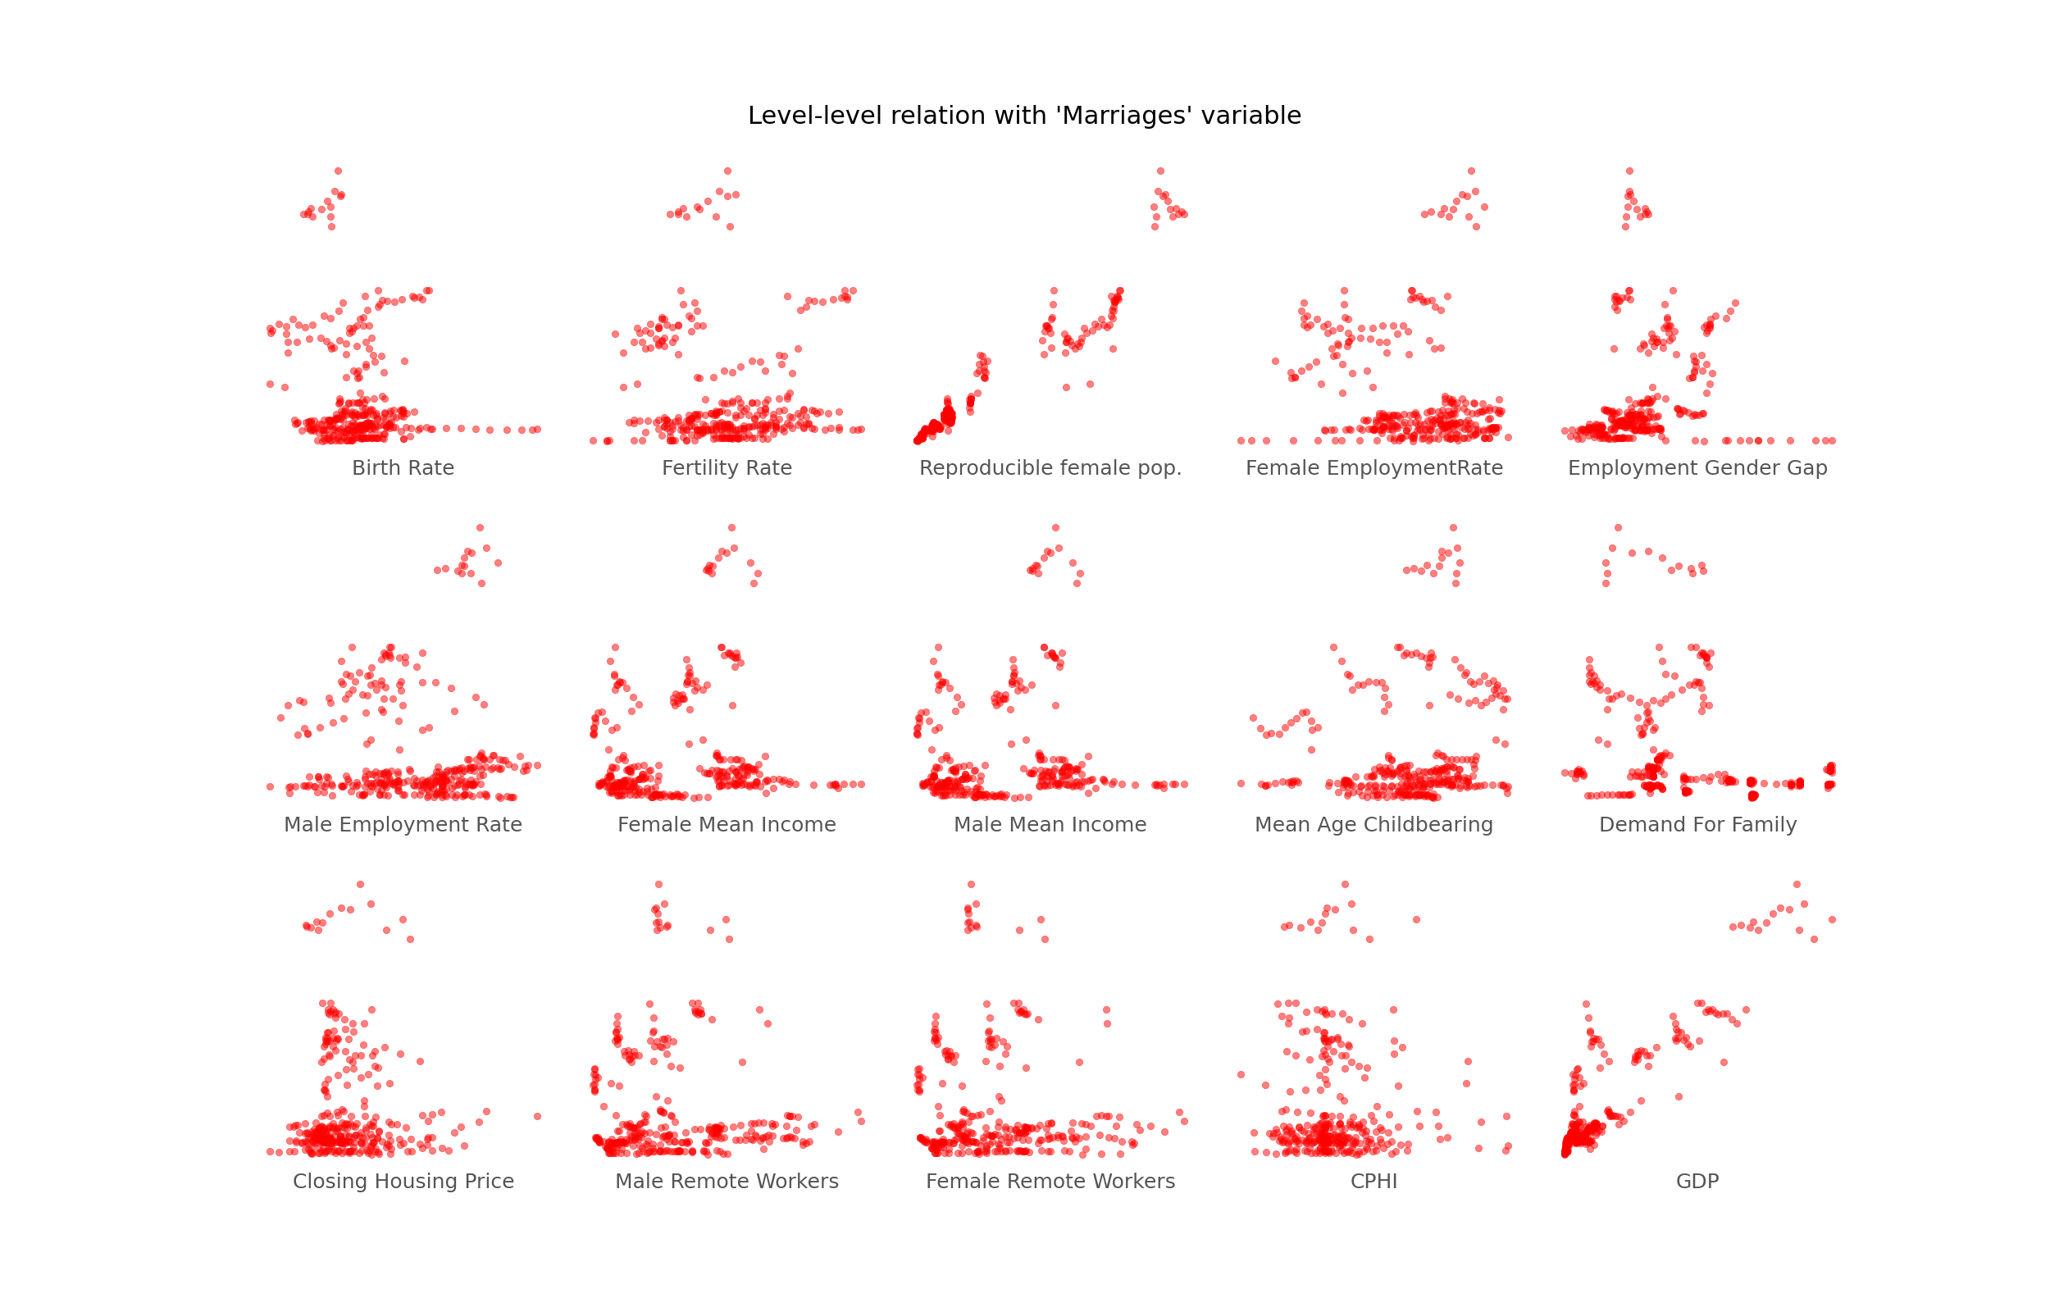
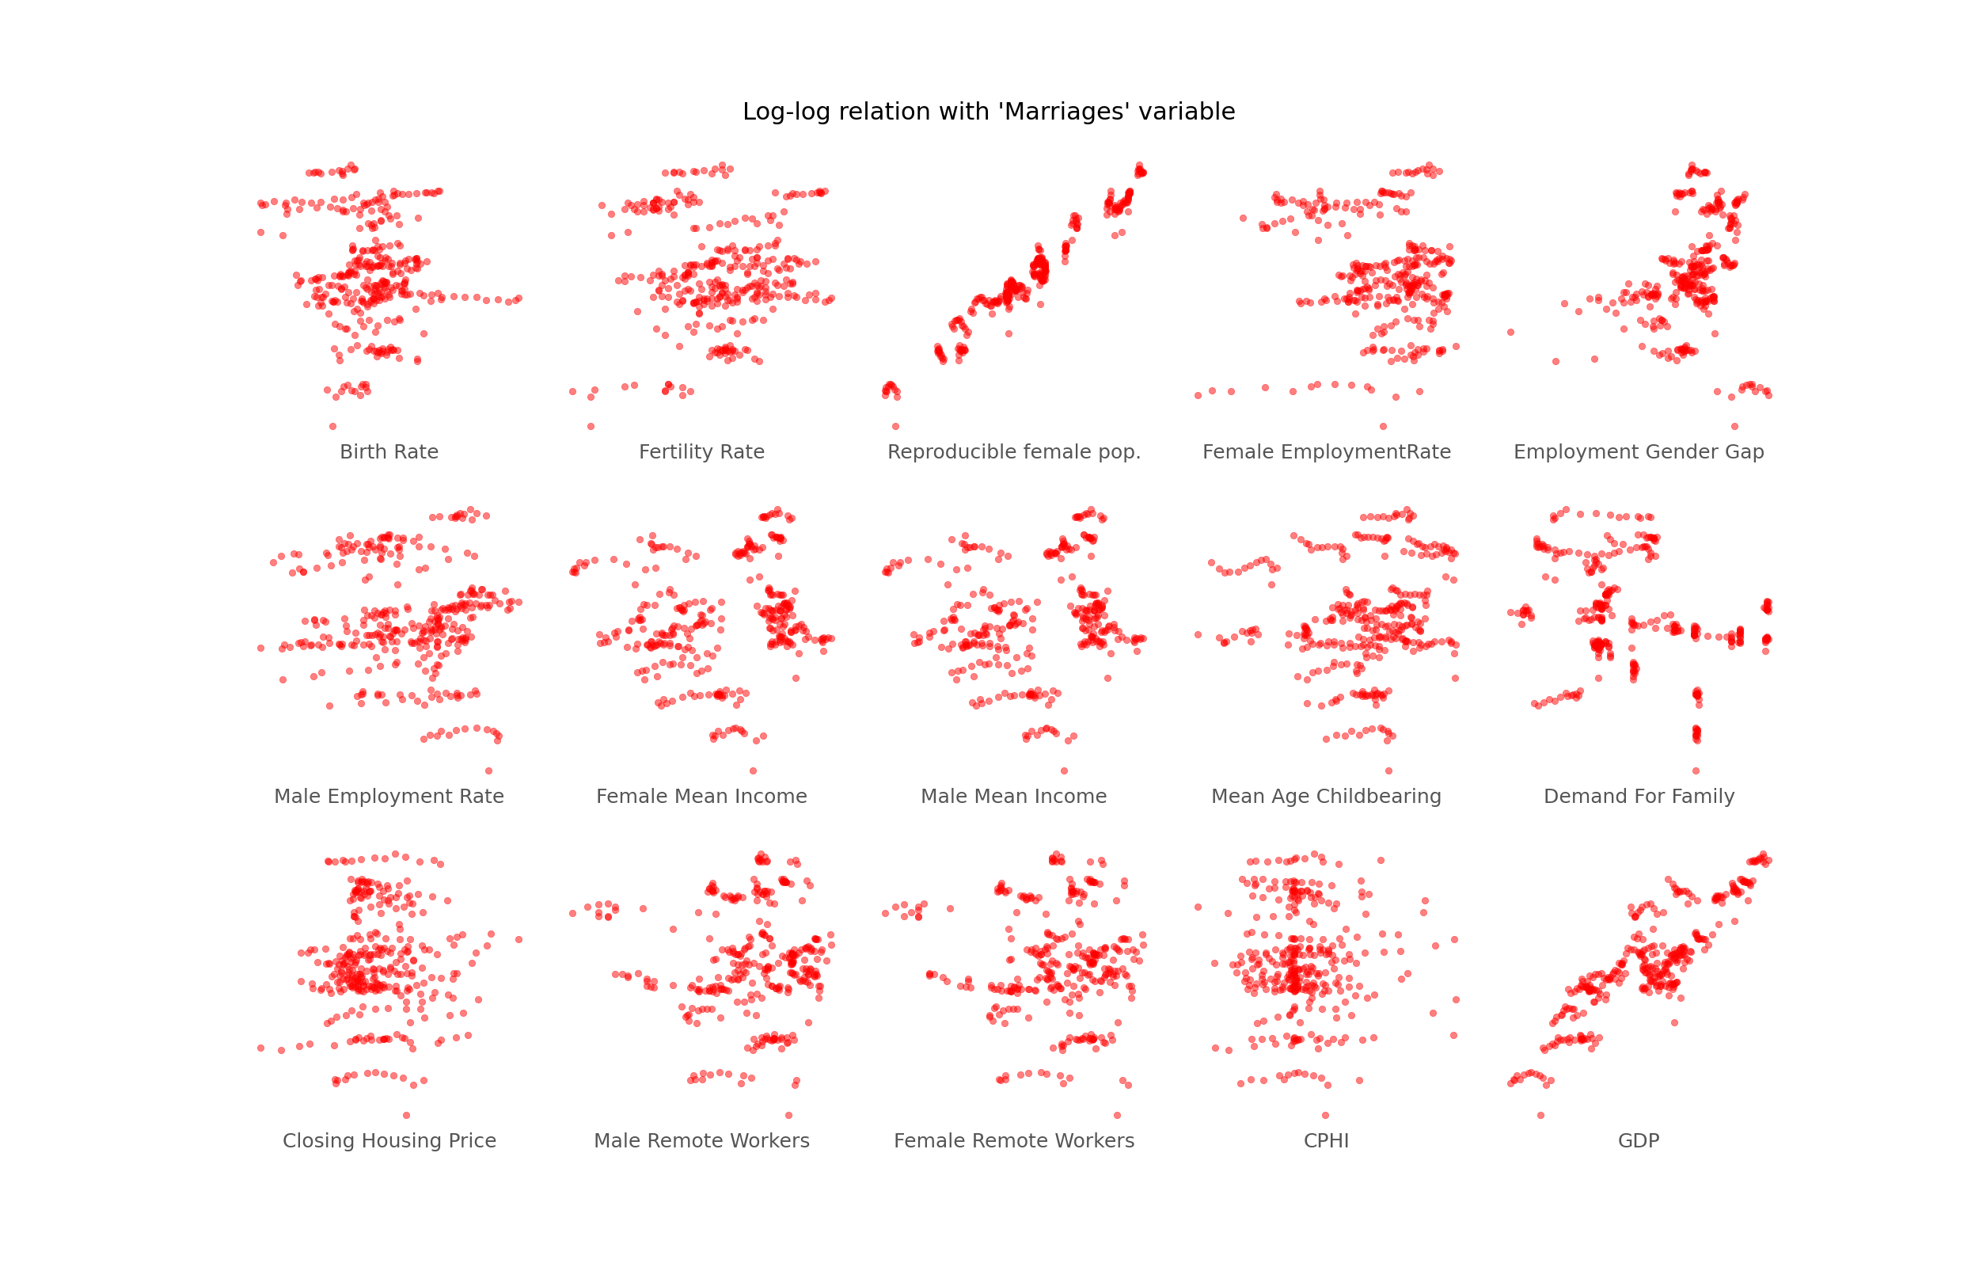
Exploratory Data Analysis
Inspecting relations

Slide 8
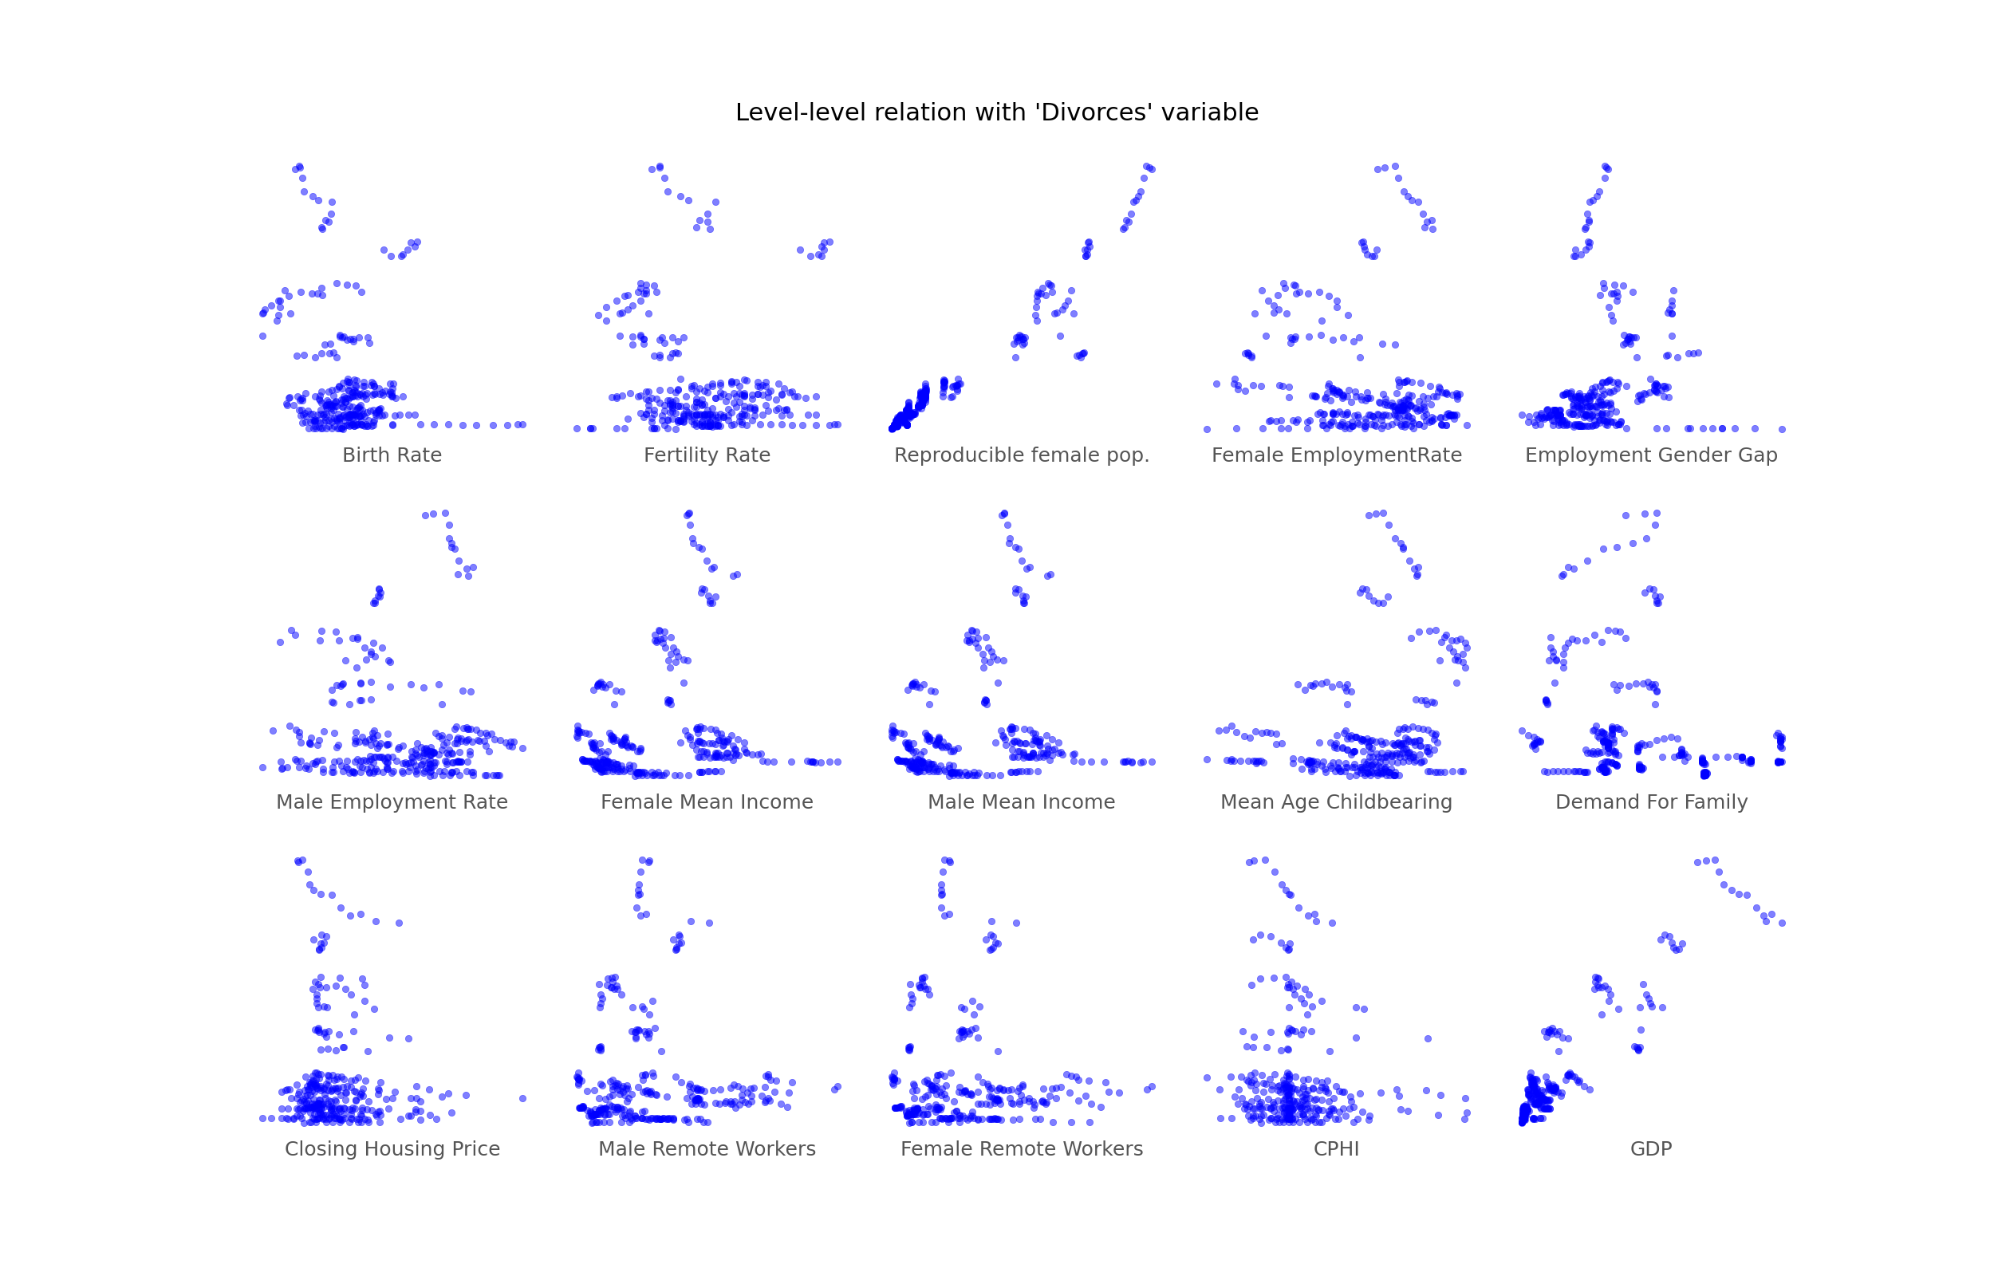
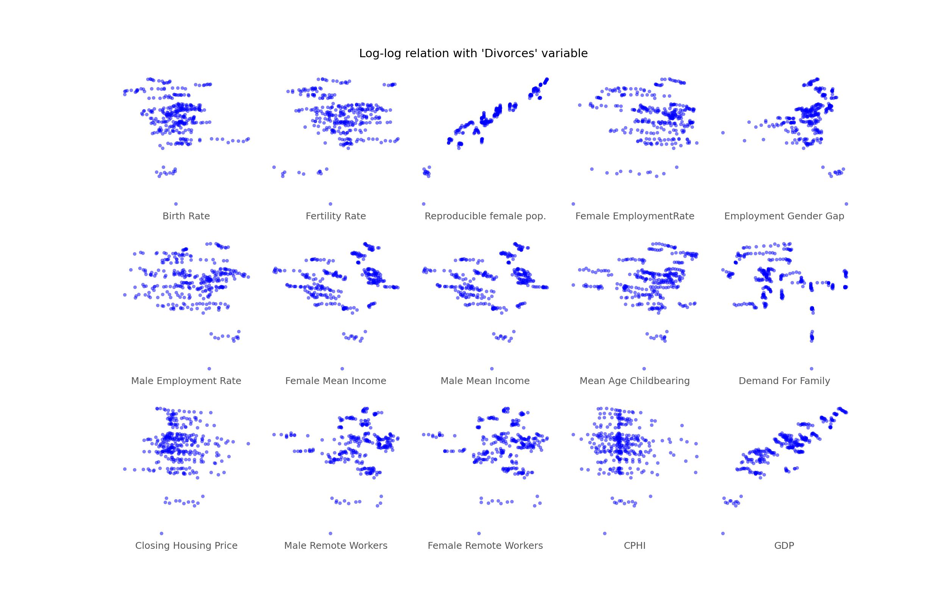
Exploratory Data Analysis
Inspecting relations

Slide 9
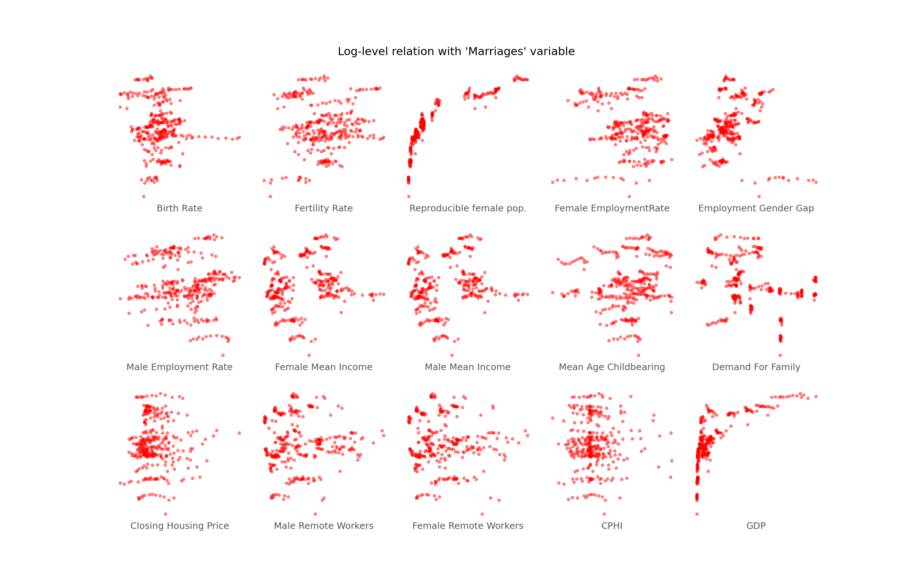
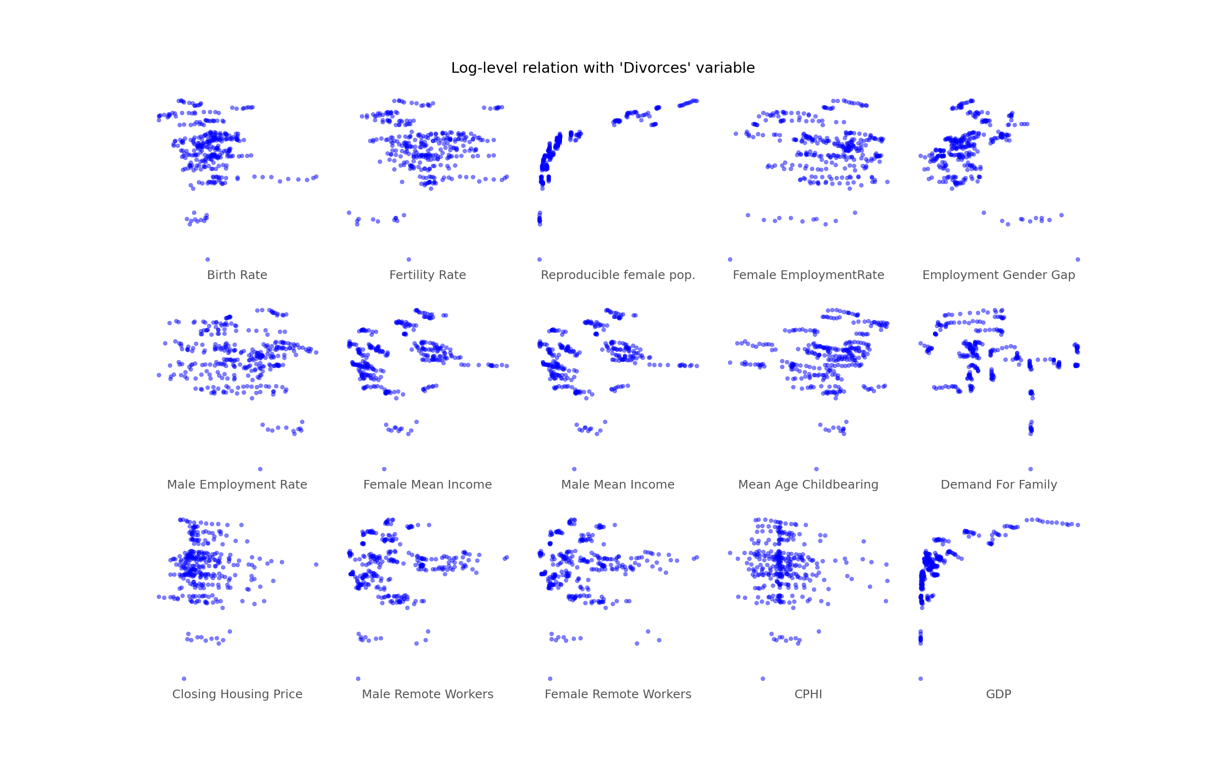
Exploratory Data Analysis
Inspecting relations

Slide 10
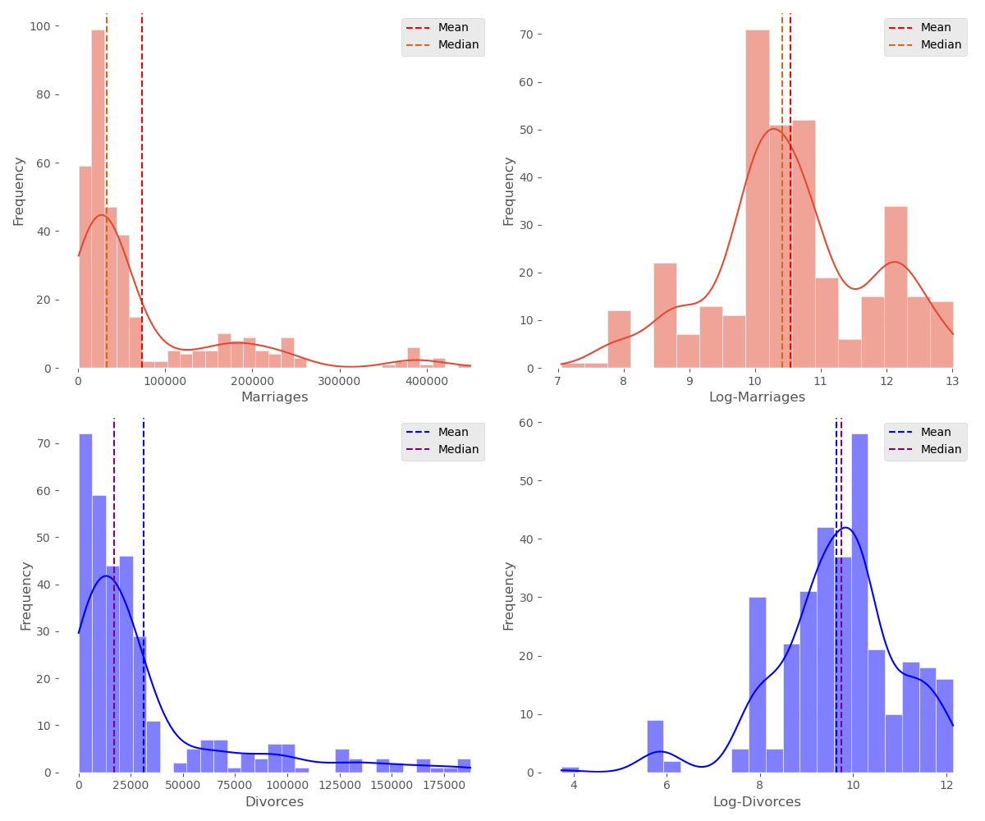
Exploratory Data Analysis
Looking for a distribution
We would like to start our analysis by considering our dataset as a pooled cross-sectional one.
Thus, we are interested in understanding the empirical distribution of the y variable.
As can be deduced from the side plots, it is interesting to apply a monotonic transformation (log) to the data empirical distribution, gaining nice statistical properties.
By using the log(y) as dependent variable we are able to control for the skewness of data (simply look at the median-mean gap).

Slide 11
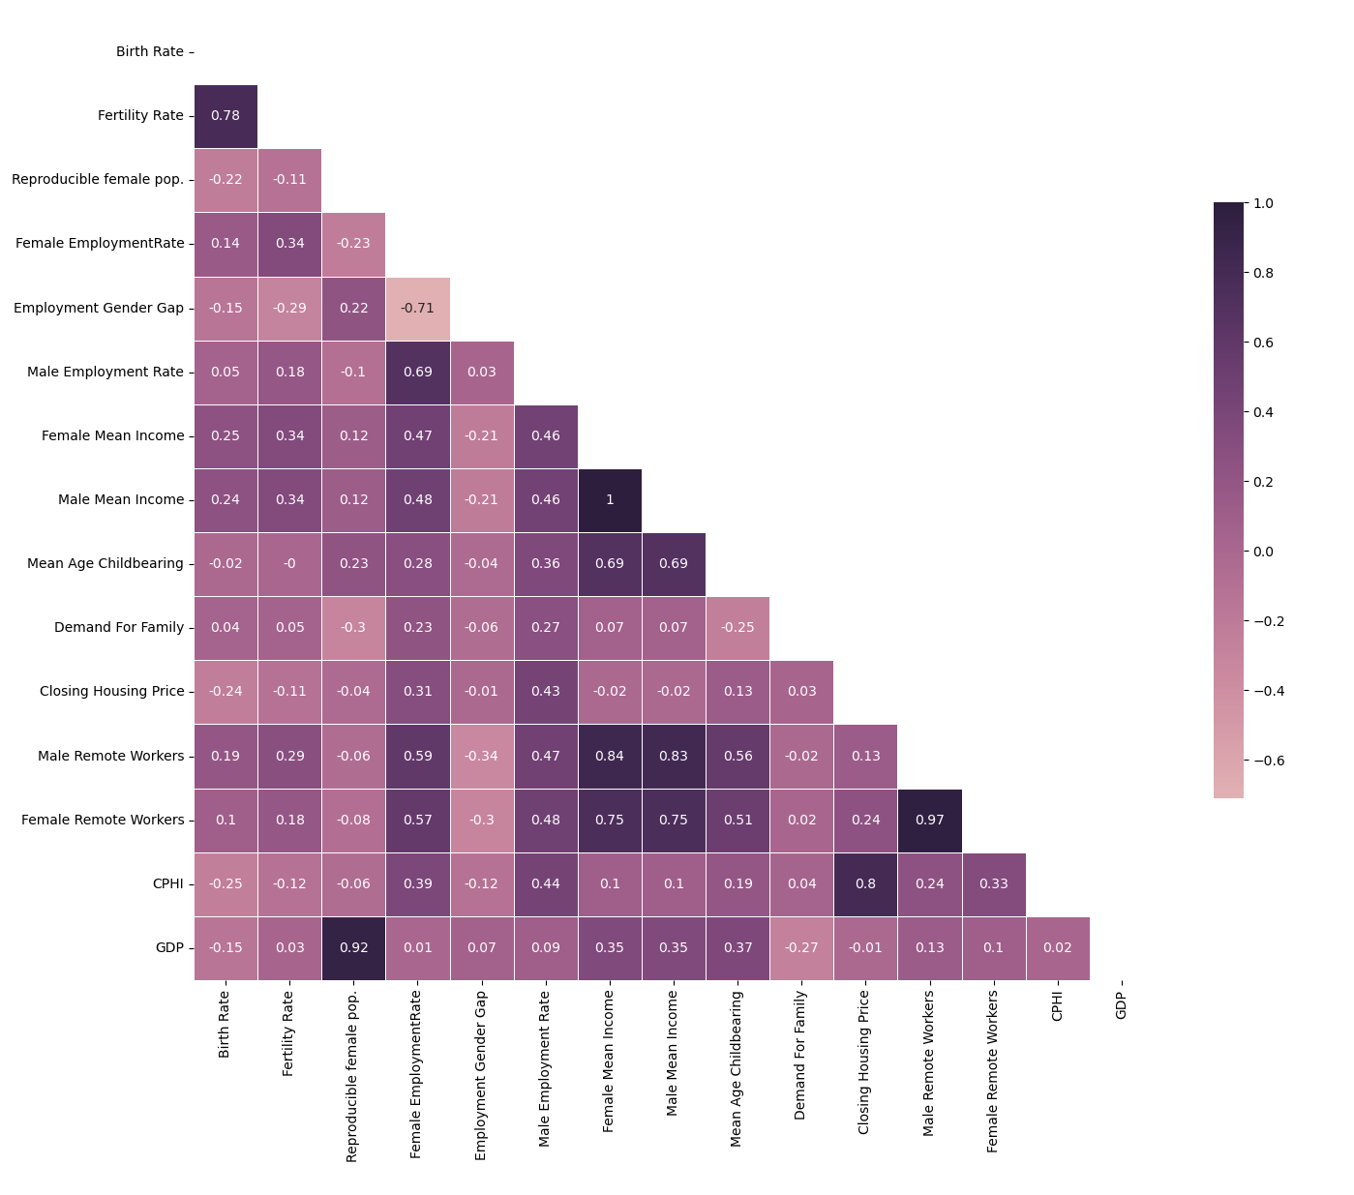
Exploratory Data Analysis
Correlation Matrix
Given the high number of independent variables, it is useful to analyze any strong correlations among them.
Some collinearity arises from the fact that:
certain variables are proportional to
each other (e.g. fertility and birth rate)
one variable defines a subset (or the complementary set) of another
It will be necessary to exclude high collinearity variables when we test our models

Slide 12
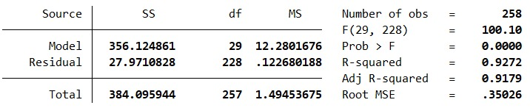
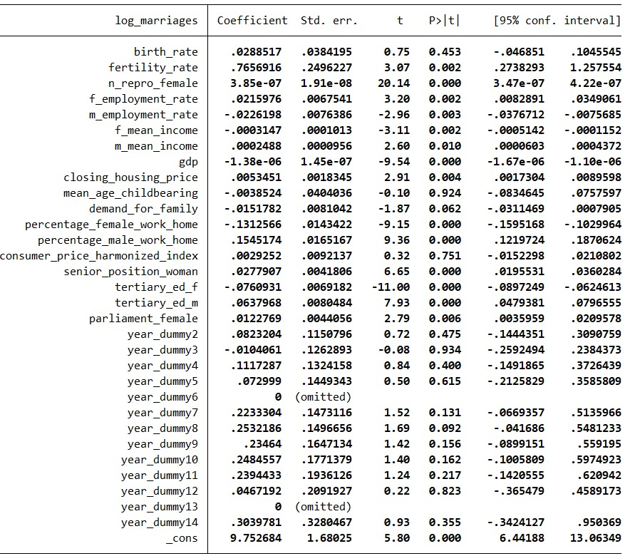
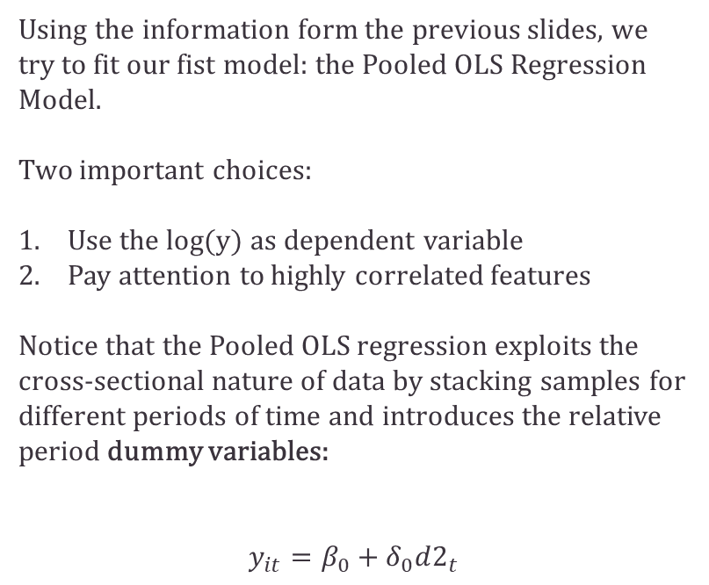
Pooled OLS
Using the information form the previous slides, we try to fit our fist model: the Pooled OLS Regression Model.
Two important choices:
Use the log(y) as dependent variable
Pay attention to highly correlated features
Notice that the Pooled OLS regression exploits the cross-sectional nature of data by stacking samples for different periods of time and introduces the relative period dummy variables:
$$y_{it}=β_{0}+δ_{0}d2_{t}$$

Slide 13
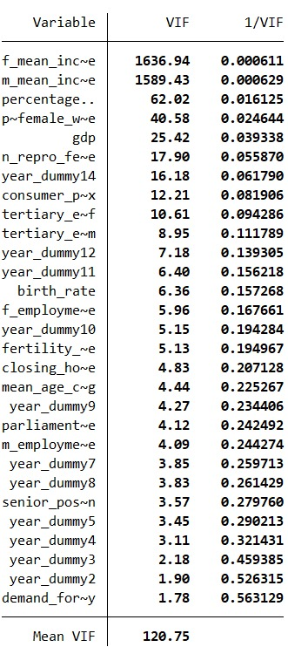
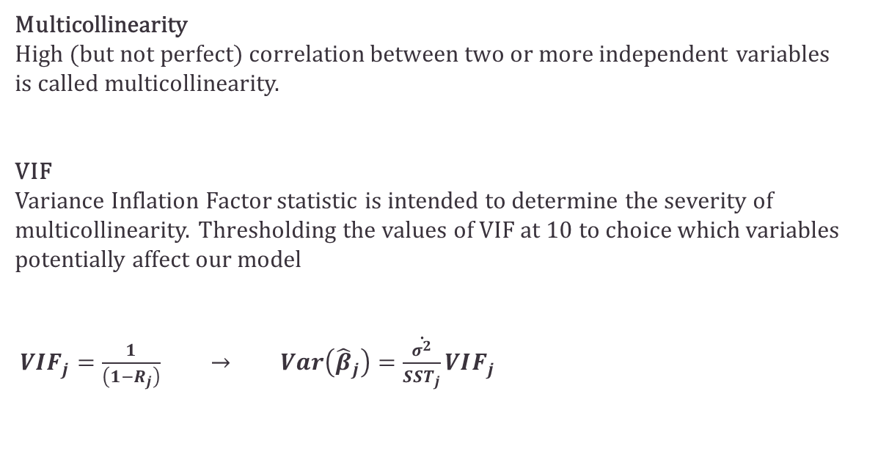
VIF correction for Multicollinearity
Multicollinearity
High (but not perfect) correlation between two or more independent variables
is called multicollinearity.
VIF
Variance Inflation Factor statistic is intended to determine the severity of multicollinearity. Thresholding the values of VIF at 10 to choice which variables potentially affect our model
$VIF_{j}=\frac{1}{\left(1−R_{j}\right)} → Var\left({\hat{β}}_{j}\right)=\dot{\frac{σ^{2}}{SST_{j}}}VIF_{j}$

Slide 14
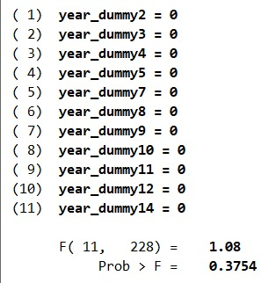
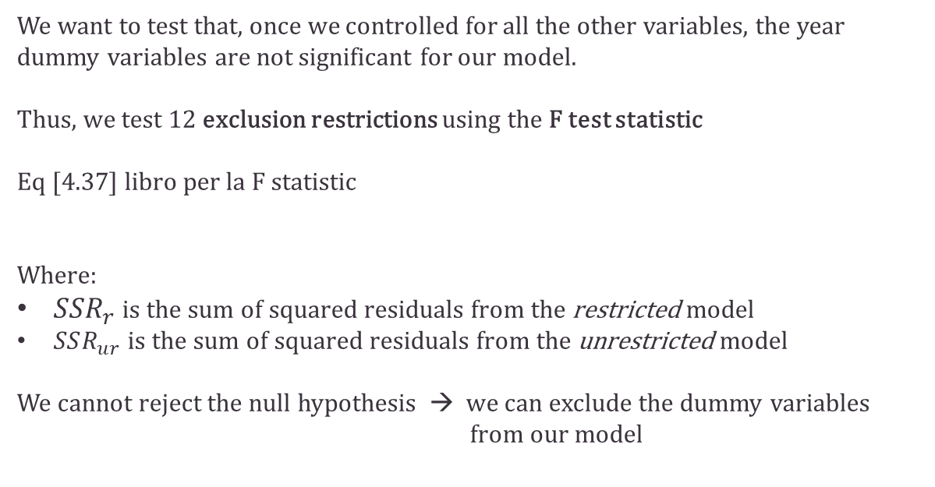
Testing the dummy variables
We want to test that, once we controlled for all the other variables, the year dummy variables are not significant for our model.
Thus, we test 12 exclusion restrictions using the F test statistic
Eq [4.37] libro per la F statistic
Where:
$SSR_{r}$ is the sum of squared residuals from the restricted model
$SSR_{ur}$ is the sum of squared residuals from the unrestricted model
We cannot reject the null hypothesis → we can exclude the dummy variables from our model

Slide 15
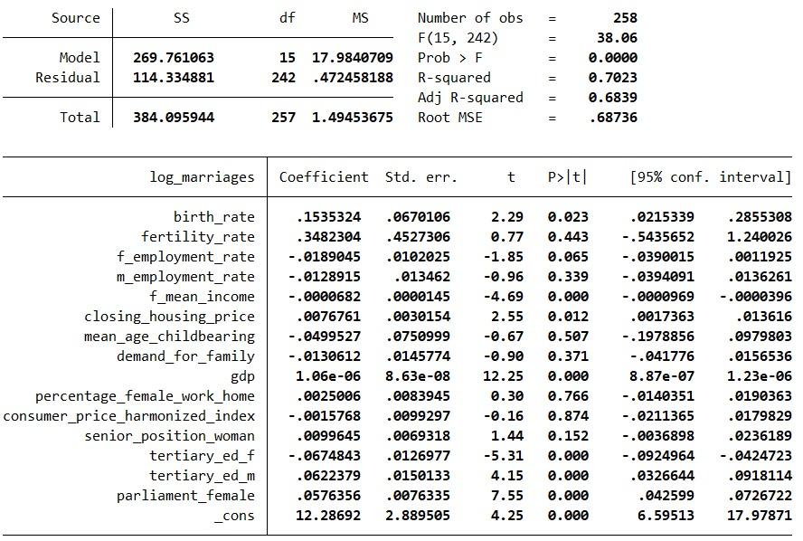
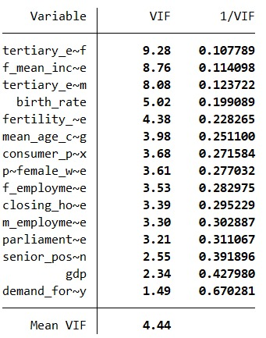
New Pooled OLS
New VIF and exclusion of temporal information
We adjust our results for multicollinearity and remove the dummy variables that are jointly non-significant
We can verify that we have no more issues with VIF, but some variable are still statistically non-significant

Slide 16
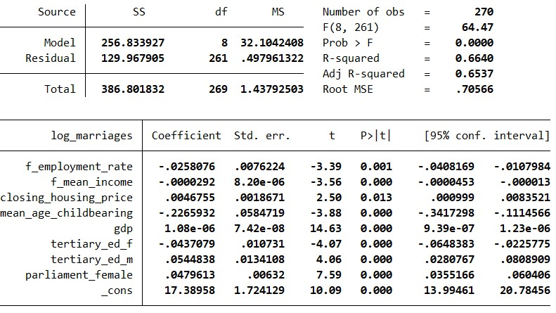
New Pooled OLS
Final feature selection
Finally, we both remove statistically irrelevant and conceptually wrong variables: we don’t want to include in our model independent variables that are mostly an effect of our dependent variable rather than a cause.
Notice that, although its statistical relevance we decide to remove the birth rate variable from our model.
Here we report the final result, in terms of selected variables.

Slide 17
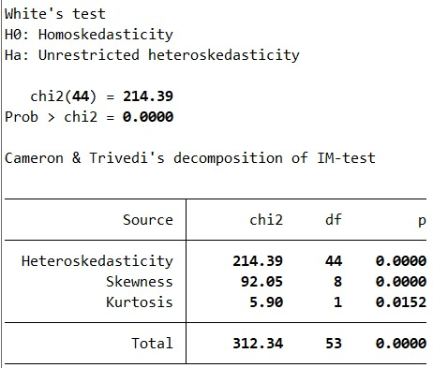
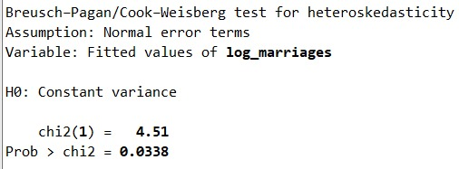
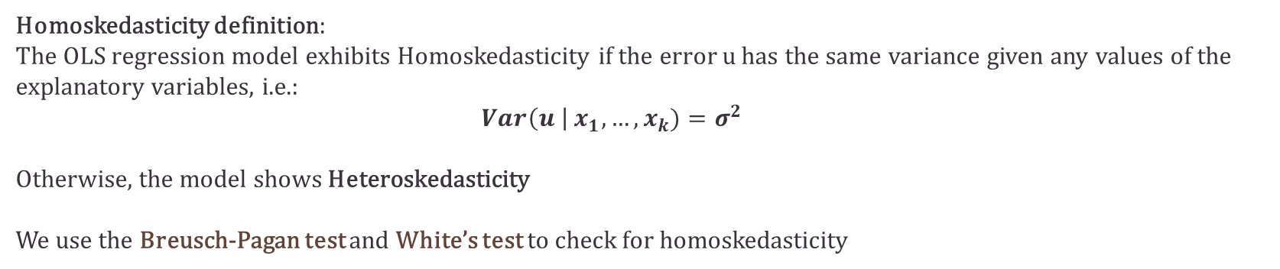
Heteroskedasticity
Testing time
Homoskedasticity definition:
The OLS regression model exhibits Homoskedasticity if the error u has the same variance given any values of the explanatory variables, i.e.:
$Var\left(u \right| x_{1},…,x_{k})=σ^{2}$
Otherwise, the model shows Heteroskedasticity
We use the Breusch-Pagan test and White’s test to check for homoskedasticity
The In both tests we reject the null hypothesis, detecting the presence of heteroskedasticity!

Slide 18
Heteroskedasticity
Correction methods
We now want to select the method to control heteroskedasticity that best fits our case. We want to use the “hetreg” command in Stata and we have two options:
Maximum Likelihood (ML) method more efficient if the mean and variance function are correctly and the errors are normally distributed
Feasible Generalized Least-Squares (FGLS ) more robust if the variance function is incorrect or the errors are nonnormal.
GLS method accounts for the heteroskedasticity structure by applying a suitable weighting matrix to the regression equations.
FGLS method, the heteroskedasticity-consistent estimated variance-covariance matrix is used to calculate the GLS weights.
From GLS to FGLS

Slide 19
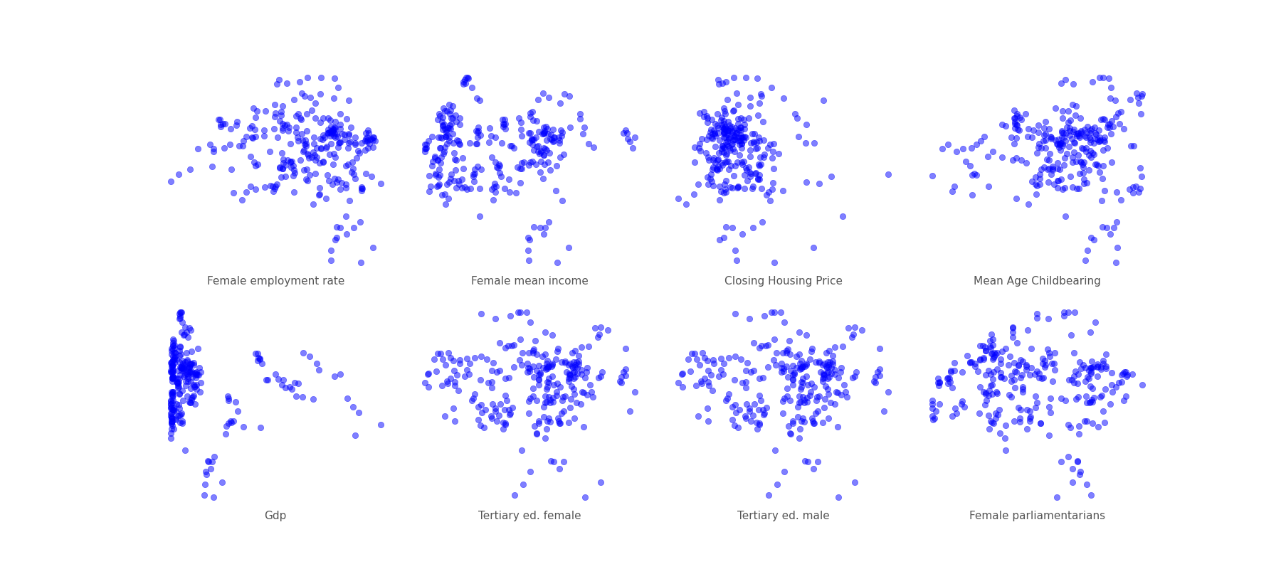
Heteroskedasticity
Inspecting the variables we want to use to model error variance in FGLS
But first all we inspect the variables on which we want to model the variance, we select the variables that seem to show some relation with the residuals

Slide 20
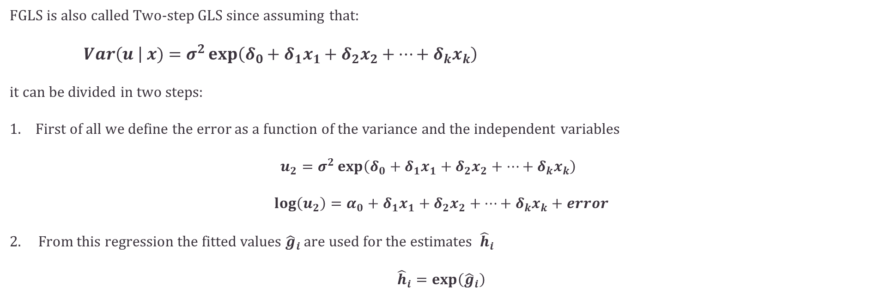
Heteroskedasticity
Feasible GLS
FGLS is also called Two-step GLS since assuming that: $Var\left(u \right| x)=σ^{2}\exp\left(δ_{0}+δ_{1}x_{1}+δ_{2}x_{2}+…+δ_{k}x_{k}\right)$
it can be divided in two steps:
First of all we define the error as a function of the variance and the independent variables $u_{2}=σ^{2}\exp\left(δ_{0}+δ_{1}x_{1}+δ_{2}x_{2}+…+δ_{k}x_{k}\right)$
$$\log\left(u_{2}\right)=α_{0}+δ_{1}x_{1}+δ_{2}x_{2}+…+δ_{k}x_{k}+error$$
2. From this regression the fitted values ${\hat{g}}_{i}$are used for the estimates ${\hat{h}}_{i}$ $${\hat{h}}_{i}=\exp\left({\hat{g}}_{i}\right)$$

Slide 21
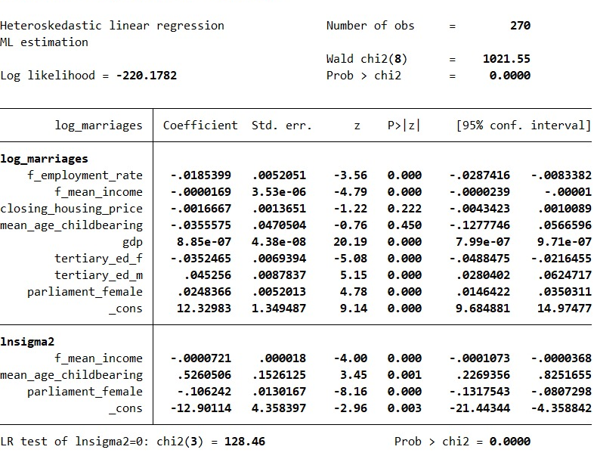
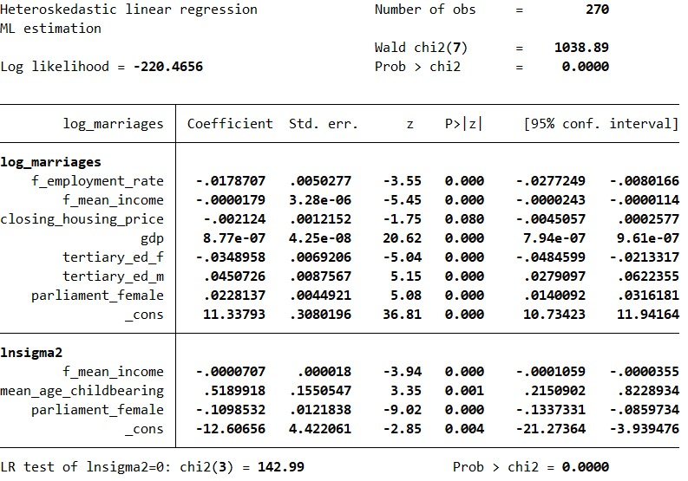
Heteroskedasticity
Heteroskedastic robust OLS regression
We thus correct the homoskedasticity defining the model variance for different combinations of independent variables
The female income variable seems to be relevant for modeling the variance
The LR test statistic supports model's heteroskedastic nature.

Slide 22
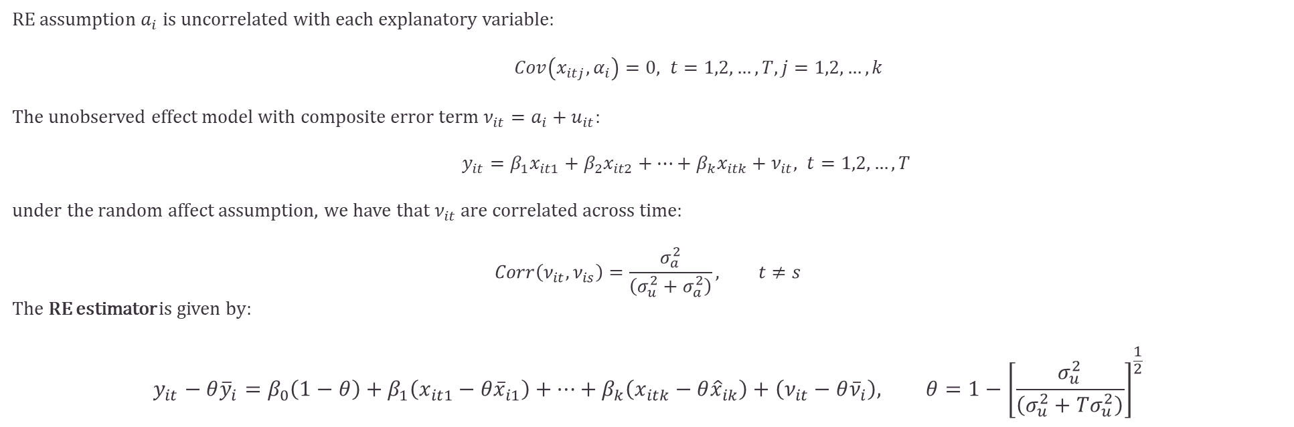
Random Effect Model
We introduce Panel Data methods, trying to solve the omitted variables problem and accounting for the unobserved effect $a_{i}.$ We start from the definition of the unobserved effect model
$$y_{it}=β_{1}x_{it1}+β_{2}x_{it2}+…+β_{k}x_{itk}+a_{i}+u_{it}, t=1,2,…,T$$
RE a$ssumption a_{i}$ is uncorrelated with each explanatory variable:
$Cov\left(x_{itj},α_{i}\right)=0, t=1,2,…,T, j=1,2,…,k$
The unobserved effect model with composite error term $ν_{it}=a_{i}+u_{it}:$
$y_{it}=β_{1}x_{it1}+β_{2}x_{it2}+…+β_{k}x_{itk}+ν_{it}, t=1,2,…,T$
under the random affect assumption, we have that $ν_{it}$ are correlated across time:
$$Corr\left(ν_{it},ν_{is}\right)=\frac{σ_{a}^{2}}{\left(σ_{u}^{2}+σ_{a}^{2}\right)}, t≠s$$
The RE estimator is given by:
$$y_{it}−θ{\overline{y}}_{i}=β_{0}\left(1−θ\right)+β_{1}\left(x_{it1}−θ{\overline{x}}_{i1}\right)+…+β_{k}\left(x_{itk}−θ{\hat{x}}_{ik}\right)+\left(ν_{it}−θ{\overline{ν}}_{i}\right), θ=1−{\left[\frac{σ_{u}^{2}}{\left(σ_{u}^{2}+Tσ_{u}^{2}\right)}\right]}^{\frac{1}{2}}$$

Slide 23
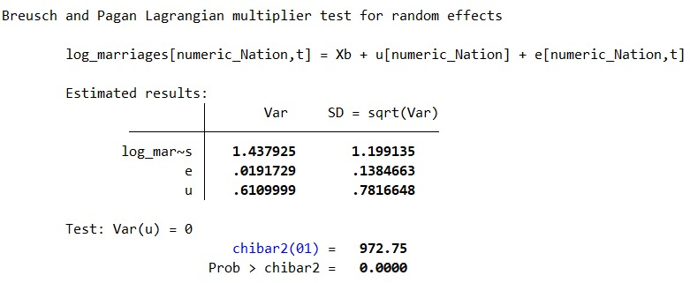
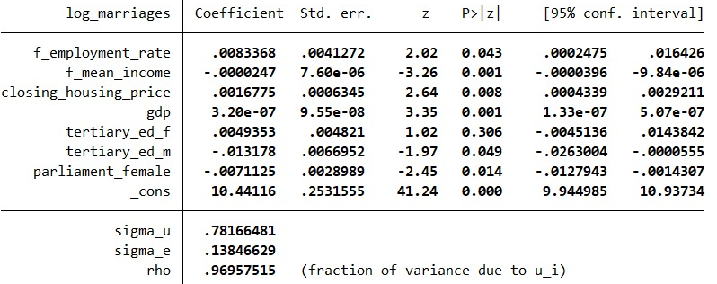
RE vs OLS
From the Breush and Pagan Lagrangian Multiplier test we deduce that we would prefer to consider the Random Effect model to the Pooled OLS
Here we report the new results for the RE model.
Notice the change in the coefficients and in the significance levels of the selected variables.

Slide 24
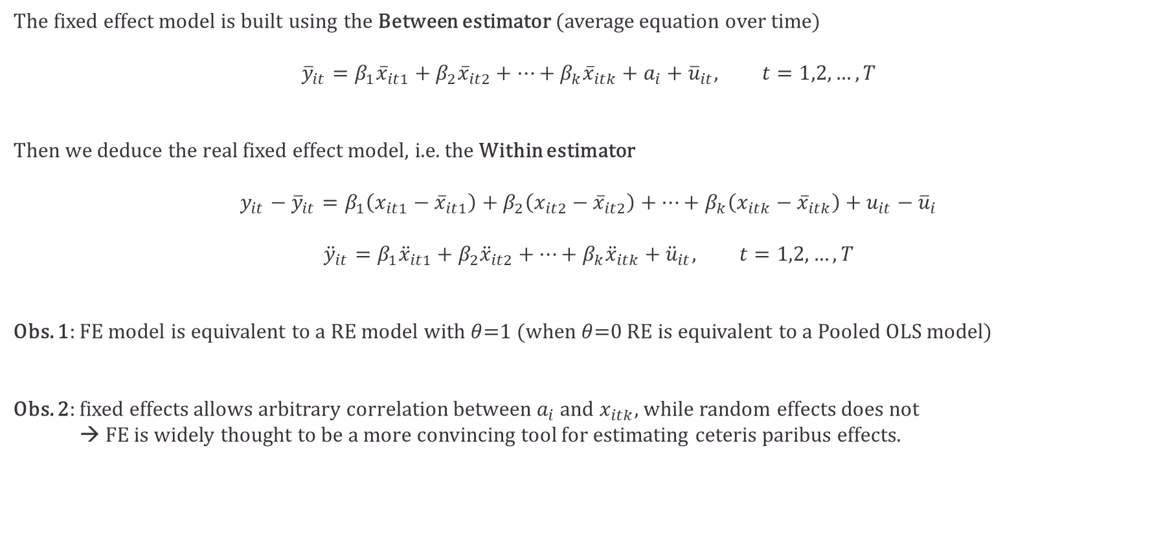
Fixed Effect Model
The fixed effect model is built using the Between estimator (average equation over time)
$${\overline{y}}_{it}=β_{1}{\overline{x}}_{it1}+β_{2}{\overline{x}}_{it2}+…+β_{k}{\overline{x}}_{itk}+a_{i}+{\overline{u}}_{it}, t=1,2,…,T$$
Then we deduce the real fixed effect model, i.e. the Within estimator
$$y_{it}−{\overline{y}}_{it}=β_{1}\left(x_{it1}−{\overline{x}}_{it1}\right)+β_{2}\left(x_{it2}−{\overline{x}}_{it2}\right)+…+β_{k}\left(x_{itk}−{\overline{x}}_{itk}\right)+u_{it}−{\overline{u}}_{i}$$
$${\ddot{y}}_{it}=β_{1}{\ddot{x}}_{it1}+β_{2}{\ddot{x}}_{it2}+…+β_{k}{\ddot{x}}_{itk}+{\ddot{u}}_{it}, t=1,2,…,T$$
Obs. 1: FE model is equivalent to a RE model with $θ$=1 (when $θ$=0 RE is equivalent to a Pooled OLS model)
Obs. 2: fixed effects allows arbitrary correlation between $a_{i}$ and $x_{itk}$, while random effects does not
→ FE is widely thought to be a more convincing tool for estimating ceteris paribus effects.

Slide 25
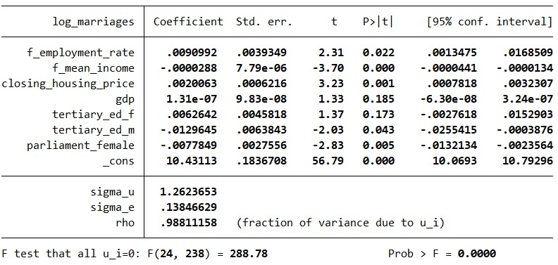
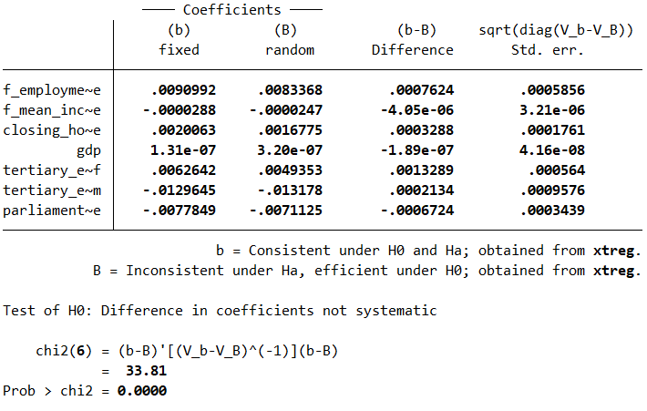
FE vs RE
The fixed effect results are quite similar to the ones obtained with RE
We use the Hausman test to select the FE model against the RE model.
We have systematic differences in the coefficients thus we opt for the FE model.

Slide 26
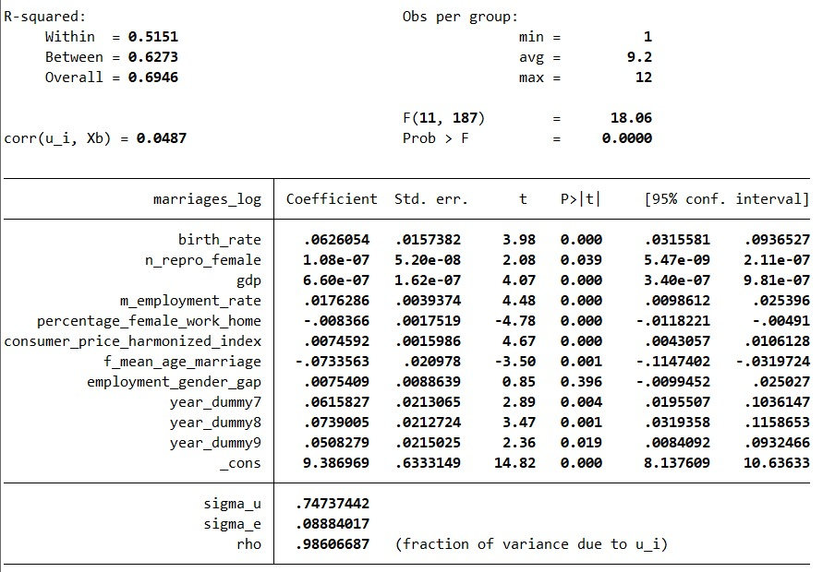
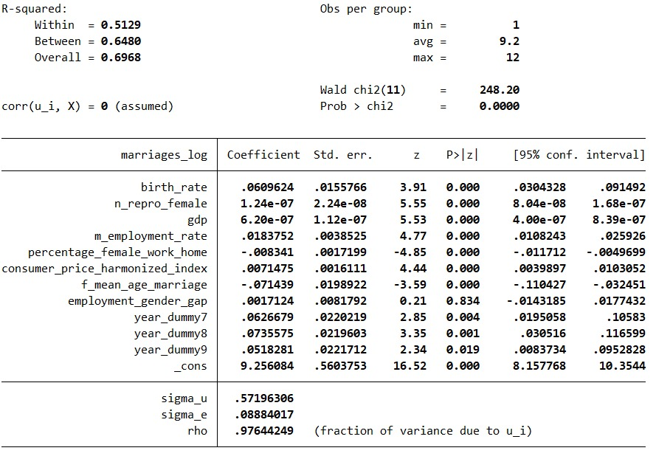
Improving the RE and FE model
Surprisingly, there is space for improvements for the both RE and FE model by reintroducing some independent variables that we previously excluded during the analysis of the Pooled OLS results.
We get this new final model that allows for better Within and Between Goodness-of-fit performances.

Slide 27
Comments
…

Slide 28
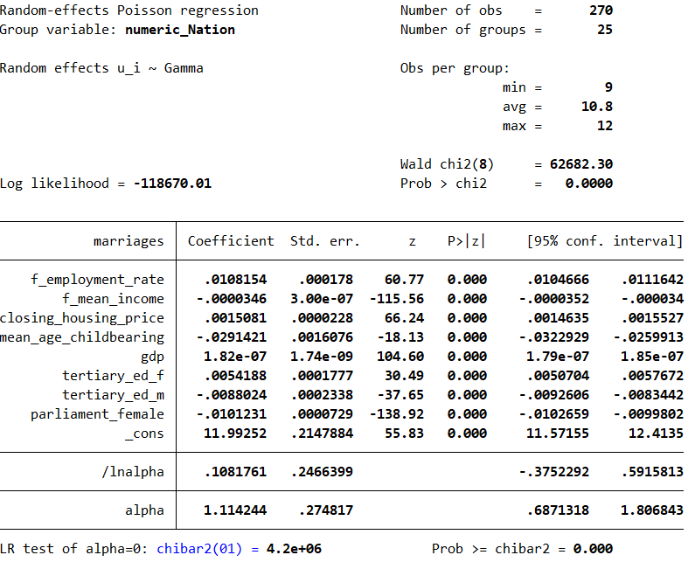
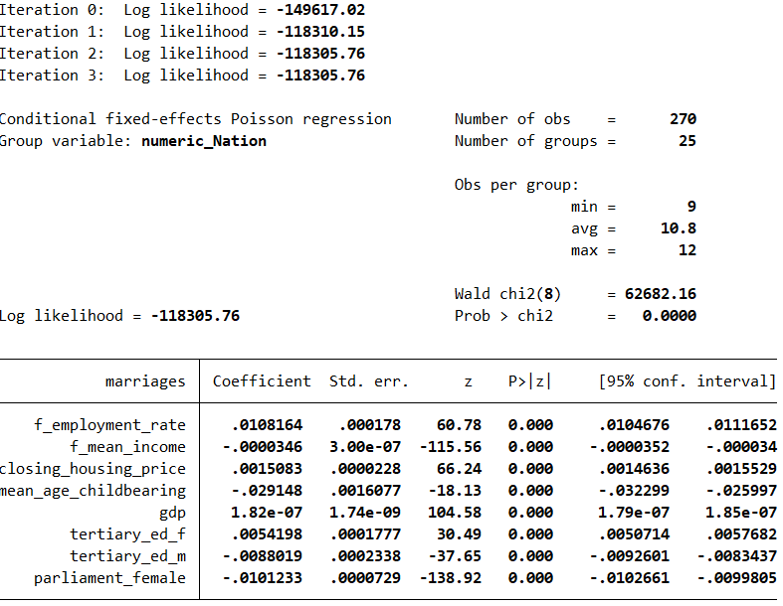
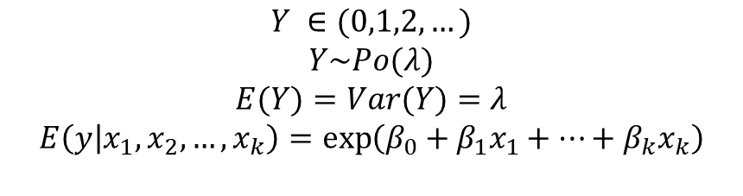
LDV with Poisson regression
$$Y ∈(0,1,2,…)$$
$$Y\sim Po(λ)$$
$$E(Y)=Var(Y)=λ$$
$$E\left(y | x_{1},x_{2},…,x_{k}\right)=\exp\left(β_{0}+β_{1}x_{1}+…+β_{k}x_{k}\right)$$
RE
FE

Slide 29
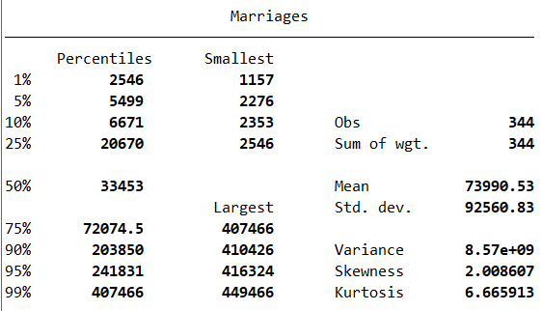
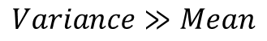
Checking Overdispersion
From the Poisson to the Negative Binomial model
$$Variance≫Mean$$
Negative Binomial Model

Slide 30
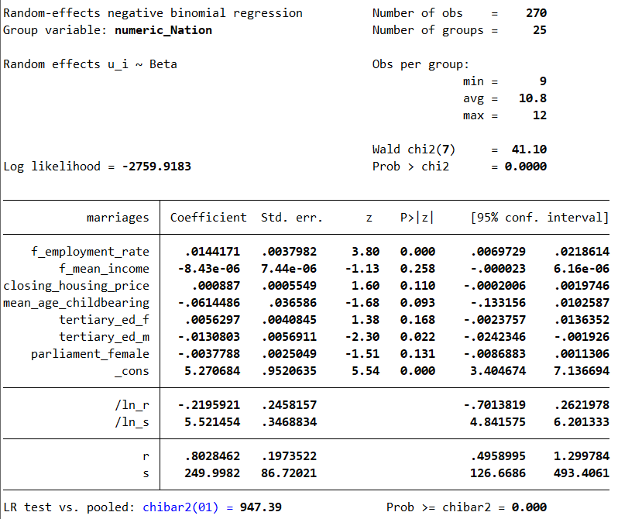
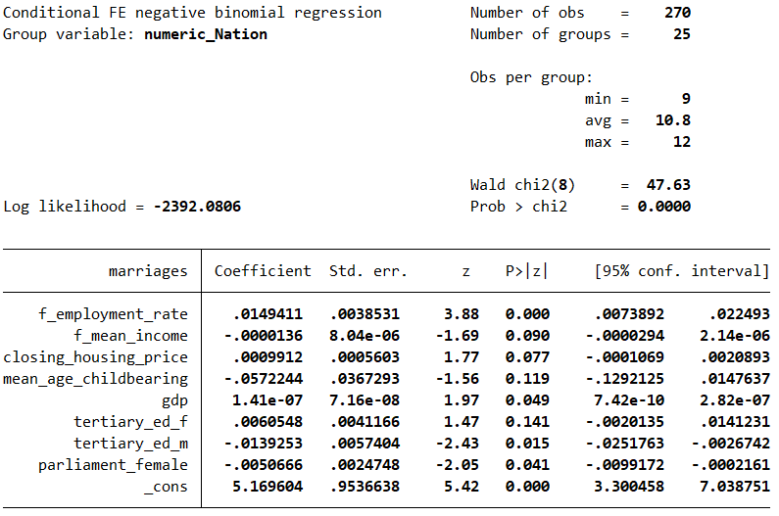
LDV with Negative Binomial
…

Slide 31
Refactoring: changing the target variable
…

Slide 32
Conclusions
The dummy for the year 2020 has great significance and magnitude, representing the abrupt decrease in marriages provoked by the COVID-19 pandemic. A great correlation with the error forced us to not include it in our models; our variables aren’t able to totally capture the complex effects the pandemic had on the society and the economy.
Our model seem to capture that higher economic security (‘m_employment_rate’, ‘consumer_price_harmonized_index’) has a positive effect on the number of marriages.
Another observed trend is the negative correlation with factors commonly attributed to an increased involvement of women in education and workforce (‘f_employment_rate’, ‘tertiary_ed_f, ‘f_mean_age_marriage’).
We consider particularly meaningful the last one: as more people decide to delay marriage to pursue education and careers relationships evolve differently, with alternative arrangements like cohabitation becoming commoner and formalizations as marriage becoming of secondary importance.

Slide 33
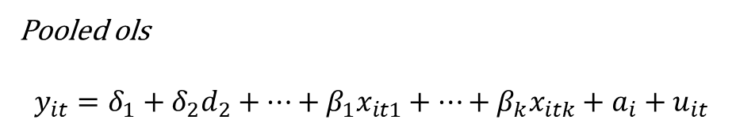
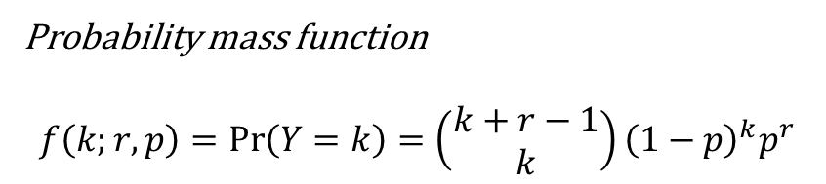
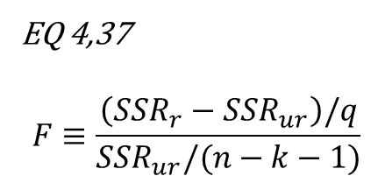
Probability mass function
$$f\left(k;r,p\right)=\operatorname{Pr}\left(Y=k\right)=\left(\begin{aligned}k+r−1 \\ k\end{aligned}\right){\left(1−p\right)}^{k}p^{r}$$
Pooled ols
$$y_{it}=δ_{1}+δ_{2}d_{2}+…+β_{1}x_{it1}+…+β_{k}x_{itk}+a_{i}+u_{it}$$
EQ 4,37
$$F≡\frac{\left(SSR_{r}−SSR_{ur}\right)/q}{SSR_{ur}/(n−k−1)}$$

